Slide 1
Shri sadguru saibaba science & COMMERCE college, ashti
Subject – Zoology
B.Sc Part II Semester III
Paper II – General physiology and Biochemistry I
Unit II
Power point presentaion on
‘ Digestive glands’
by
Maheshkumar S.Seelamwar
Assistant Professor
Department of Zoology
Shri Sadguru Saibaba Science & Commerce college, Ashti, Dist.Gadchiroli

Slide 2
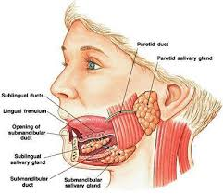
Salivary gland
Salivery gland is is the tissue in our mouth that expels saliva.
As exocrine gland, it secrets the saliva into the epithelial surface of our mouth.
Three pairs of salivery gland.
1.The Paratid 2. Submandibular 3.Sublingual
Saliva begins the process of digestion in the mouth.
The paratid glands lie below and slightly in front of each ear. They are largest of salivery glands.
Submandibular glands are situated just under the cover of angle of the mandible.
Sublingual glands lie in the anterior part of floor of the mouth.
The digestive juices secreted by these glands are commonly called saliva.
Saliva contains 90 % water and digestive enzyme ptyalin ( salivary amylase).
Saliva also contains mucin and small quantity of calcium salts.
Carbohydrates gets partly digested due to saliva.

Slide 3
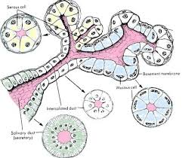
Histology of Salivary gland
The salivary glands are compound tubular glands in which the glandular cells lie within supporting frame work of connective tissue carrying the blood vessel.
Glandular cells are arranged in single layer around the central cavity which recieves the secretion from the surrounding cells, such a unit called acinus or an alveolus.
Small ducts from these acini join to form large duct which pours the secretion finally into the buccal cavity.
This arrangement in which the acini are related to one another like the grapes in bunch, is called racemose.
All salivary glands are surrounded by fibrous capsule.
Saliva :
It is viscous, colourless, cloudy fluid
Average pH value 6.8 with range between 5.6-7.6 ( sli alk)
Specific gravity 1.002 – 1.008
Amount secreted in day – 750 – 1500 ml
Composition – 98-99% water , 1-2 % ( mineral salts, amylase, mucus, lysozyme , immunoglobulins, blood clotting factors)
Serous cell
Basement membrane
Mucous cell
Salivary duct
( secretory)

Slide 4
Functions of saliva
1. Moistens oral mucosa 10. Pellicle formation
2. Swallowing 11. Maintenance of tooth integrity
3. Stimulation of taste bud 12.Tissue repair
4. Buffer 13. Digestion
5. Digestion
6. Antimicrobial activity
7. Mineralization
8. Oral hygiene
9. Protection

Slide 5
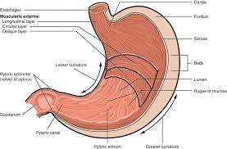
sTOMACH
There are four regions of stomach: the cardia , fundus, body and pylorus.
The cardia ( or cardiac region ) is the point where the oesophagus connects to the stomach and through food passes into the stomach.
Located inferior to the diaphragm, above and to the left of the cardia , is the dome shaped fundus.
Below the the fundus is the body , the main part of stomach.
The funnel shaped pylorus connects the stomach to the duodenum. The wider end of the funnel, the pyloric antrum, connects to the body of stomach.
The narrower end is called the pyloric canal , which connects which connects to the duodenum.
The smooth muscle pyloric sphincter is located at this latter point point of connection and controls stomach emptying.
Cardia
Fundus
Serosa
Pyloric spincter
( valve)
Body
Lumen
Duodenum
Pyloric canal

Slide 6
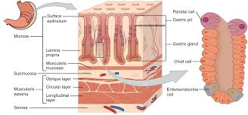
Histology of stomach
The wall of stomach is made of the same four layers as most of the rest of the alimentary canal , but with adaptation to the mucosa and muscularis for the unique functions of this organ.
The stomach mucosa’s epithelial lining consist only of surface mucus cells, which secrete a protective coat of alkaline mucus.
A vast number of gastric pits dot the surface of the epithelium, giving it the appearance of well used pincushion and mark the entry to each gastric gland, which secrets a complex digestive fluid called as gastric juice.
Although the walls of the gastric pits are made up primarily of mucus cells, the gastric glands are made up of different type of cells.
The glands of cardia and pylorus are composed primarily of mucus secreting cells.
Cells that make up the pyloric antrum secrete mucus and hormones.

Slide 7
stomach
The much larger glands of fundus and body of stomach, the site of chemical digestion, produce most of gastric secretions.
These glands are made up of a variety of secretory cells. These include parietal cells, chief cells, mucuos neck cells and enteroendocrine cells.
Parietal cells –
Located in middle region of gastric gland .
Produces both hydrochloric acid ( pH 1.5 to 3.5) and intrinsic factor.
HCL required to activate protien digestive ennzyme , pepsin. The acidity kills much of the bacteria ingested food and helps to denature protiens.
Intrinsic factor is glycoprotien necessary for the absorption of vtamin B12 in small intestine .
Chief cells –
Located in basal region of gastric gland .
These secrete pepsinogen the inactive proenzyme form of pepsin.
HCL required for coversion of pepsinogen into pepsin.
Mucus neck cells –
Loacted in the upper part of stomach.
Secretes thin acidic mucus and role this mucus is not currently known.

Slide 8
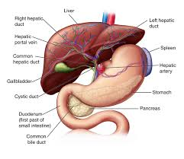
Structure and function of liver
The liver is the largest gland of the body.
It’s upper and anterior surfaces are smooth and curved to fit the under surface of the diaphragm; the posterior surface is irregular in outline.
It consist of 3 lobes in frog : ( right , left and median)
5 lobes in rabbit :( left lateral, left central , spigelian , right central and caudate )
4 lobes in man :
(right , left ,quadrates and caudate lobe).
These are surrounded by thick capsule.

Slide 9
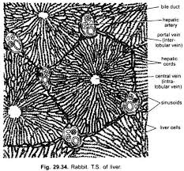
histlogy of liver
A) Parenchyma
It is composed of closely packed glandular epithelium.
The parenchyma is arranged in the form of hepatic plates (hepatic cords) that branch and anastomose.
The center of radiation is axially situated central intra – lobular vein. From here the plates spread peripherally in a branching, spoke like manner.
A plate is one cell thick, except at regions of branching.
A bile capillary is a tubule coursing between the opposite faces of hepatic cells.
B) Sinusoids
The hepatic cells are separated by hepatic sinusoids that converge radially into the central vein.
In their radial course , they tunnel parenchyma into plate like cords. Such channels communicates with both the central vein and vessel at periphery.
They receive blood from hepatic artery (25%) and portal vein ( (75%) at the periphery of the lobule and discharged it into the central vein in the axis of the lobule.

Slide 10
Functions of liver
Secretion : Bile salts( sodium taurocholate and glycocholate), bile pigments ( bilirubin and biliverdin), cholesterol, mucin, lecithin and fats etc.
Excretion : Erytrocytes haemoglobin bilirubin and biliverdin stercobilin
Glycogenesis : Excess quantity carbohydrate ( glucose) converted into glycogen.
Glycogenolysis : Glycogen converted into glucose
Gluconeogenesis : Formation of glucose from non carbohydrate sources like protien and fat.
Lipogenesis : Excess glucose converted into fat and stored in the liver.
Transamination and deamination : Amino acids converted into fat or carbohydrate.
Haemopoiesis : fomrmation of RBC.
Store house of blood :
Blood clotting : Fibrinogen, prothrombin and other coagulation fator formed in liver.
Production of blood plasma protiens : Serum albumin ans serum globulin
Syntesis and storage of vitamins : Synthesize vit A. Store fat soluble vitamuns A,D,E,K & Vit B12
Detoxification :
Alohol metabolism : Alcohol acetaldehyde acetyl coA CO2 AND H20
Desaturation of fat :
Phagocytosis : Kupffer cells in liver sinusoids phagocytose and remove bacteria, worm blood elementsand foreign particles.

Slide 11
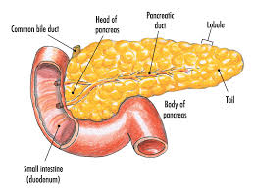
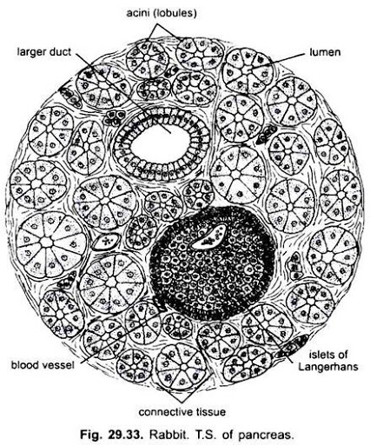
Pancreas
It is an elongated organ that lies behind and below the stomach. The cells of which pancreatic juice.
This gland is located in the loop of duodenum.
Pancreas act as both exocrine and endocrine gland. Exocrine part consist of grape like cluster of cluster of secretory cells that form sacs known as acini, which connect to ducts thate eventually empty into the first portion of the intestine of duodenum.
Embeded within the pancreatic acinar tissue there is a relatively small amount cellular tissue , the interalveolar cell –islets or the Islets of Langerhans. This tissue produces internal secretion called insulin.
The pancreatic juice secreted by pancreatic gland reaches the intestine through the duct of Wirsung which usually join with the comman bile duct before opening into the first part of the duodenum.

Slide 12
Pancreatic digestive enzymes
Pancreatic secretion contains multiple enzymes for digesting all of the three major types of food: proteins, carbohydrates, and fats.
It also contains large quantities of bicarbonate ions, which play an important role in neutralizing the acidity of the chyme emptied from the stomach into the duodenum.
The most important of the pancreatic enzymes for digesting proteins are trypsin, chymotrypsin, and carboxypolypeptidase. By far the most abundant of these is trypsin. Trypsin and chymotrypsin split whole and partially digested proteins into peptides of various sizes but do not cause release of individual amino acids.However, carboxypolypeptidase does split some peptides into individual amino acids, thus completing digestion of some proteins all the way to the amino acid state.
The pancreatic enzyme for digesting carbohydrates is pancreatic amylase, which hydrolyzes starches, glycogen, and most other carbohydrates (except cellulose) to form mostly disaccharides and a few trisaccharides.
The main enzymes for fat digestion are (1) pancreatic lipase, which is capable of hydrolyzing neutral fat into fatty acids and monoglycerides; (2) cholesterol esterase, which causes hydrolysis of cholesterol esters; and (3) phospholipase, which splits fatty acids from phospholipids.
When ﬁrst synthesized in the pancreatic cells, the proteolytic digestive enzymes are in the inactive forms trypsinogen, chymotrypsinogen, and procarboxypolypeptidase, which are all inactive enzymatically. They become activated only after they are secreted into the intestinal tract. Trypsinogen is activated by an enzyme called enterokinase, which is secreted by the intestinal mucosa when chyme comes in contact with the mucosa. Also, trypsinogen can be autocatalytically activated by trypsin that has already been formed from previously secreted trypsinogen. Chymotrypsinogen is activated by trypsin to form chymotrypsin, and procarboxypolypeptidase is activated in a similar manner.

Slide 13
Thank you………………..

